Slide 1
Distributed Systems
Characterization and Design
Notes:
The questions that we try to answer this lecture are:
What is a distributed system, why should we bother to construct systems in a distributed fashion and what are the key properties of a distributed system?

Slide 2
OUTLINE
1. What is a Distributed System
2. Examples of Distributed Systems
3. Common Characteristics
4. Basic Design Issues
5. Summary
Notes:
In the first part we shall attempt a definition of the term distributed system and compare it to centralized systems.
For a better appreciation of the issues that are involved in distributed systems, we will review several distributed systems that everybody in this class has come across (probably without recognizing that this is a distributed system)
We shall then elaborate on the common characteristics of distributed systems. These can be used to assess and compare distributed systems. They will also provide us with (initial) guidelines as to what we should remember when we construct distributed systems.
A summary will repeat what you should remember from this weeks lecture.

Slide 3
1. WHAT IS A DISTRIBUTED SYSTEM?
Definition: A distributed system is one in which components located at networked computers communicate and coordinate their actions only by passing messages. This definition leads to the following characteristics of distributed systems:
Concurrency of components
Lack of a global ‘clock’
Independent Memory
Independent failures of components
Notes:
We employ the (adapted) definition of Colouris, Dollimore and Kindberg (2005) of a distributed system.
It requires autonomous computers to be interconnected through a network.
Each computer has to be equipped with distributed operating system software, which enables the computers to coordinate activities and to share resources in a controlled way
We also require transparency of distribution for the computer users. They shall not have to be aware of the fact that the system is distributed.

Slide 4
1.1 CENTRALIZED SYSTEM CHARACTERISTICS
Component shared by users all the time
All resources accessible
Software runs in a single process
Single point of control
Single point of failure
Notes:
To clarify the consequences of distributing a system, we compare its characteristics to those we find in centralized systems.
In a centralized system, there is a single component that may be decomposed further. However, its parts (such as classes in an object-oriented program) are not autonomous, i.e the component possess full control over them at all times. As there are no other components, there is no need to provide an interface to the component.
If the component supports multiple users (e.g. a relational database), the users share the complete component at all times.
A centralized system runs in a single process. There is no need to take concurrency control and synchronization into account.
There is only a single point of control. The component is in exactly one state that is determined by the program counter of the processor, register variable contents and the virtual memory occupied by the process.
Either the system is running or it is not.Situations cannot occur where part of the system or parts of its interconnection have failed and need to recover.

Slide 5
1.2 DISTRIBUTED SYSTEM CHARACTERISTICS
Multiple autonomous components
Components are not shared by all users
Resources may not be accessible
Software runs in concurrent processes on different processors
Multiple points of control
Multiple points of failure
Notes:
In a distributed system, there are multiple components that may be decomposed further. These components are autonomous, i.e. they possess full control over their parts at all times. The components, however, have to provide interfaces to be able to use each other.
There may be components that are used by only some users but are not used by others. It is then beneficial to have these components residing on machines that are local to the users that use them.
A distributed system runs in multiple processes. These processes are usually not executed on the same processor. Hence inter-process communication involves communication with other machines through a network. Different levels of abstraction (confer the ISO/OSI reference model) are involved in this communication.
There are multiple points of control, but these are not totally independent. Components have to take into account that they are being used by other components and have to react properly to requests.
There are multiple points of failure in a distributed system. The system may fail because a component of the system has failed. It may also fail if the network has broken down. It may also fail if the load on a component is so high that it does not respond within a reasonable time frame. Even so, the distributed system is more fault-tolerant than a centralized one.

Slide 6
2. EXAMPLES OF DISTRIBUTED SYSTEMS
Local Area Network and Intranet
Database Management System
Automatic Teller Machine Network
Internet/World-Wide Web
Mobile and Ubiquitous Computing
Notes:
We now review several systems that most of you have come across already (possibly without being aware that they are distributed).
This review will provide you with a better understanding of the issues that are to be tackled during distributed systems construction.

Slide 7
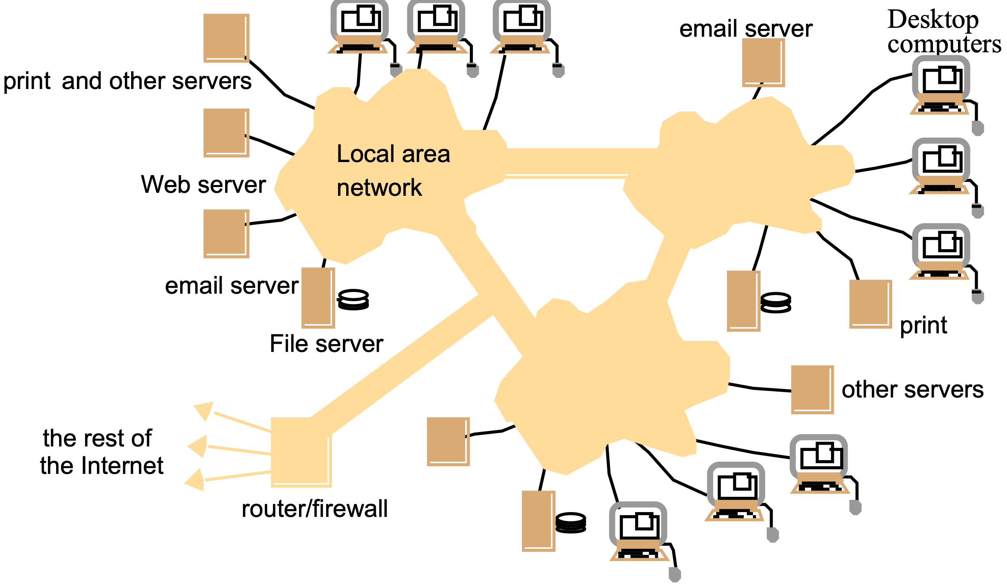
2.1 LOCAL AREA NETWORK
Notes:
A local area network consists of a number of different computers. Workstations and Personal computers provide the front-end for network users. Different servers provide shared services.
One or several network file servers provide data storage services. Any workstation and PC may henceforth store files on disks maintained by these file servers.
A local name server maps machine names to IP addresses, user names to user ids and group names to group ids. Any machine can request a service to resolve a certain name.
One or several print servers control the access to shared printers.Workstations and PCs have the server printing jobs for them.
Another component provides a gateway to the wide area network.
As a user you need not be aware which machine provides which service.
Name servers provide the information regarding machine (by IP address), user names (by user ids), and group name (by group ids).
Local area networks can be connected together to form Intranets.

Slide 8
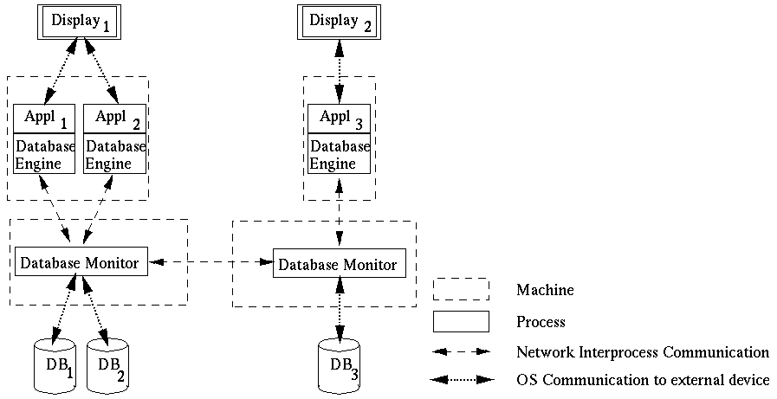
2.2 DATABASE MANAGEMENT SYSTEM
Notes:
Different client applications want to access and update shared data in a database.
Client applications might be banking systems, real-estate agencies, airline-ticket reservation systems accessing data like balances of bank accounts, details of property that are for sale or to let, or airfares and aircraft reservation data.
The database is physically distributed over several processors to take advantage of local data accesses for increased performance of client applications.
Data may be replicated to reduce the impact of failures of a processor and/or the network.
Each processor runs a database monitor that implements the mapping between the database seen by clients and the physical database stored on the different processors.
Database monitors have to cooperate with each other to implement client accesses to remote data, updates of replicated data and concurrency control.
The physical distribution of data is therefore transparent to clients.

Slide 9
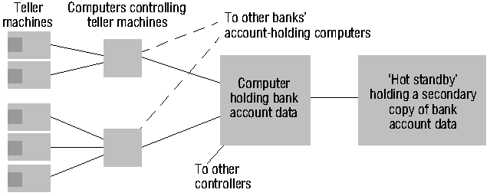
2.3 AUTOMATIC TELLER MACHINE NETWORK
Notes:
An automatic teller machine network enables bank customers to withdraw cash from their bank account.
Banks and building societies maintain large networks of teller machines.
Customer have high security, privacy and reliability requirements.
Customers may want to withdraw cash from their account through a ´foreign´ teller machine.
A front-end computer controls one or several tellers. It
transfers withdrawal requests to the computer of the account holder´s bank,
awaits the bank granting the request, and
therefore has to be interoperable with heterogeneous computer systems (Hang Seng Bank may have different account management systems than HongKong Bank and Bank of China).
Each bank has fault-tolerant systems to quickly recover from failures of their account holding computers. An example is the ´Hot standby´ computer which maintains a copy of the account database and can replace the main computer within seconds.

Slide 10
2.4 INTERNET
intranet
☎
ISP
☎
☎
☎
backbone
satellite link
desktop computer:
server:
network link:
Notes:
Internet is the largest distributed system in the world.

Slide 11
2.4.2 WEB SERVERS AND WEB BROWSERS
http://www.google.comlsearch?q=lyu
www.google.com
Web servers
Browsers
www.uu.se
Internet
http://www.uu.se/
www.w3c.org
File system of
http://www.w3c.org/Protocols/Activity.html
www.w3c.org
Protocols
Activity.html
Notes:
A Web browser is a user interface to the world´s biggest distributed system, the Internet.
A Web page includes links to other Web pages. These links are specified as URLs.
An URL is the name of a protocol (ftp, http, etc.), the name of a site (gateway1.cse.cuhk.edu.hk) and the name of a file.
To follow a link to a remote Web page, your Web browser
talks to the local name server to resolve the symbolic site name into an IP address (137.189.89.153).
talks to the http daemon running on that web site and requests the delivery of the Web page addressed by the URL.
To obtain a file from a remote ftp site, your Web browser
resolves the site name with the local name server
talks to the ftp daemon running on that site and performs an anonymous login.
switches the daemon into an appropriate transfer mode and
obtains the file addressed by the file addressed in the URL.
To send an e-mail, your Web browser
opens a new dialog window where you can enter the addressee(s) and the e-mail text
talks to the local sendmail daemon to have it delivering the e-mail to the sendmail daemons on the sites of your addressees.

Slide 12
2.5 MOBILE AND UBIQUITOUS COMPUTING
Internet
Host intranet
GSM/GPRS
Home intranet
Wireless LAN
gateway
Mobile
phone
Printer
Laptop
Camera
Host site
Notes:
Mobile and ubiquitous computer extend the access of Internet and distributed system architecture from wire-line connections to wireless connections.

Slide 13
3. COMMON CHARACTERISTICS
What are we trying to achieve when we construct a distributed system?
Certain common characteristics can be used to assess distributed systems
Heterogeneity
Openness
Security
Scalability
Failure Handling
Concurrency
Transparency
Notes:
Why do we bother about constructing distributed systems? Constructing a centralized system appears to be much easier!
Some properties of a distributed system cannot be achieved by a centralized system. It is worthwhile to keep these properties in mind during the design or assessment of a distributed system.
Heterogeneity: I can access all the documents that are available on the Internet, even though the documents are located in different type of machines.
Openness: I have credit cards from Hang Seng Bank and Wells Fargo Bank in U.S.A. and can use them at each others tellers. These banks, however, would never develop a common centralized teller system. It is because their systems are open and interoperable that I have this flexibility.
Security: I want to purchase products in e-Commerce. I don’t want other people to steal my credit card number.
Scalability: Distributed systems, such as the Internet, grow each day to accommodate more users and to withstand higher load. (Hong Kong stock trading broker is on-line and you can open accounts and do on-line trading from home PC).
Failure Handling: Two (distributed) account databases are managed by the bank to quickly recover from a break-down.
Concurrency: Multiple database users can concurrently access and update data in a distributed database system. The database system preserves integrity against concurrent updates and users perceive the database as their own copy. They are, however, able to see each others changes after they have been completed.
Transparency: When using a distributed system it appears to users as if it were centralized.

Slide 14
4. BASIC DESIGN ISSUES
General software engineering principles include rigor and formality, separation of concerns, modularity, abstraction, anticipation of change, …
Specific issues for distributed systems:
Naming
Communication
Software structure
System architecture
Workload allocation
Consistency maintenance
Notes:
According to the Fundamentals of Software Engineering book by Ghezzi et. al., software engineering principles include (1) Rigor and Formality (2) Separation of Concerns (3) Modularity (4) Abstraction (5) Anticipation of Change (6) Generality and (7) Incrementality.
Specific issues need to be resolved for the design of software for distributed systems.

Slide 15
4.1 NAMING
A name is resolved when translated into an interpretable form for resource/object reference.
Communication identifier (IP address + port number)
Name resolution involves several translation steps
Design considerations
Choice of name space for each resource type
Name service to resolve resource names to comm. id.
Name services include naming context resolution, hierarchical structure, resource protection
Notes:
Name: names that can be interpreted by users or by programs
Identifier: names that can be interpreted or used only by programs. At each name translation step, a name or identifier is mapped to a lower-level identifier that can be used to specify a resource when communicating with some software component, until a communication id is produced that is acceptable to the communication subsystem, and that is used to transmit a request to a resource manager.
Names having some hierarchical structure
representing an internal hierarchic name space (/etc/passwd)
organizational hierarchy (cse.cuhk.edu.hk)
a flat set of numeric or symbolic identifier
advantages: each part of a name is resolved relative to a separate context, and the same name may be used with different meaning in different context
Names are always resolved relative to some context. Contexts are represented by name tables or databases. In the case of file systems, each directory represents a context. To resolve a name, we must supply the context and the name. A name service accepts requests for the translation of names or identifiers in one name space to identifier in some other space. It also handles name registration, deletion, and provides up-to-date information.
Naming schemes can be designed to protect the resources from unauthorized access. Each id is chosen so that it is hard to reproduce, and their client’s authority is being checked by the naming service. Ids which meet this requirement are known as capabilities.

Slide 16
4.2 COMMUNICATION
Separated components communicate with sending processes and receiving processes for data transfer and synchronization.
Message passing: send and receive primitives
synchronous or blocking
asynchronous or non-blocking
Abstractions defined: channels, sockets, ports.
Communication patterns: client-server communication (e.g., RPC, function shipping) and group multicast
Notes:
Synchronization prevent sending or receiving process from continuing until the other process makes an action that frees it.
Each message-passing action involves the transmission by the sending process of a set of data values (a message) through a specified communication mechanism (a channel or port) and the acceptance by the receiving process of a message.
Synchronous (blocking) means that the sender waits after transmitting a message until the receiver has performed a receive operation.
Asynchronous (non-blocking) means that the message is placed in a queue of messages waiting for the receiver to accept them and the sending process can proceed immediately.
Distributed systems can be designed entirely in terms of message-passing, but there are certain useful communication patterns (collective of primitives for high-level operations).
Client-server communication model is for service provision: 1. Transmission of a request from a client to a server; 2. Execution of the request by the server; 3. Transmission of a reply to the client.
Function shipping: the server acts as an execution environment and interpreter for programs, and clients transmit sequences of instructions for interpretation (e.g., PostScript files sent to printer).
Multicasting: sending a message to the members of a specified group of processes. Multicasting examples: locating an object, fault tolerance, and multiple update.

Slide 17
4.3 SOFTWARE STRUCTURE
Layers in centralized computer systems:
Applications
Middleware
Operating system
Computer and Network Hardware
Notes:
Middleware provides run-time support for programming language, such as interpreters and libraries
OS is the main system software to manage basic resources and to provide user and application services:
Basic resource management:
- memory allocation and protection
- process creation and processor scheduling
- peripheral device handling
User and application services:
- user authentication and access control (e.g., login facilities)
- file management and file access facilities
- clock facilities

Slide 18
4.4 SYSTEM ARCHITECTURES
Client-Server
Peer-to-Peer
Services provided by multiple servers
Proxy servers and caches
Mobile code and mobile agents
Network computers
Thin clients and mobile devices

Slide 19
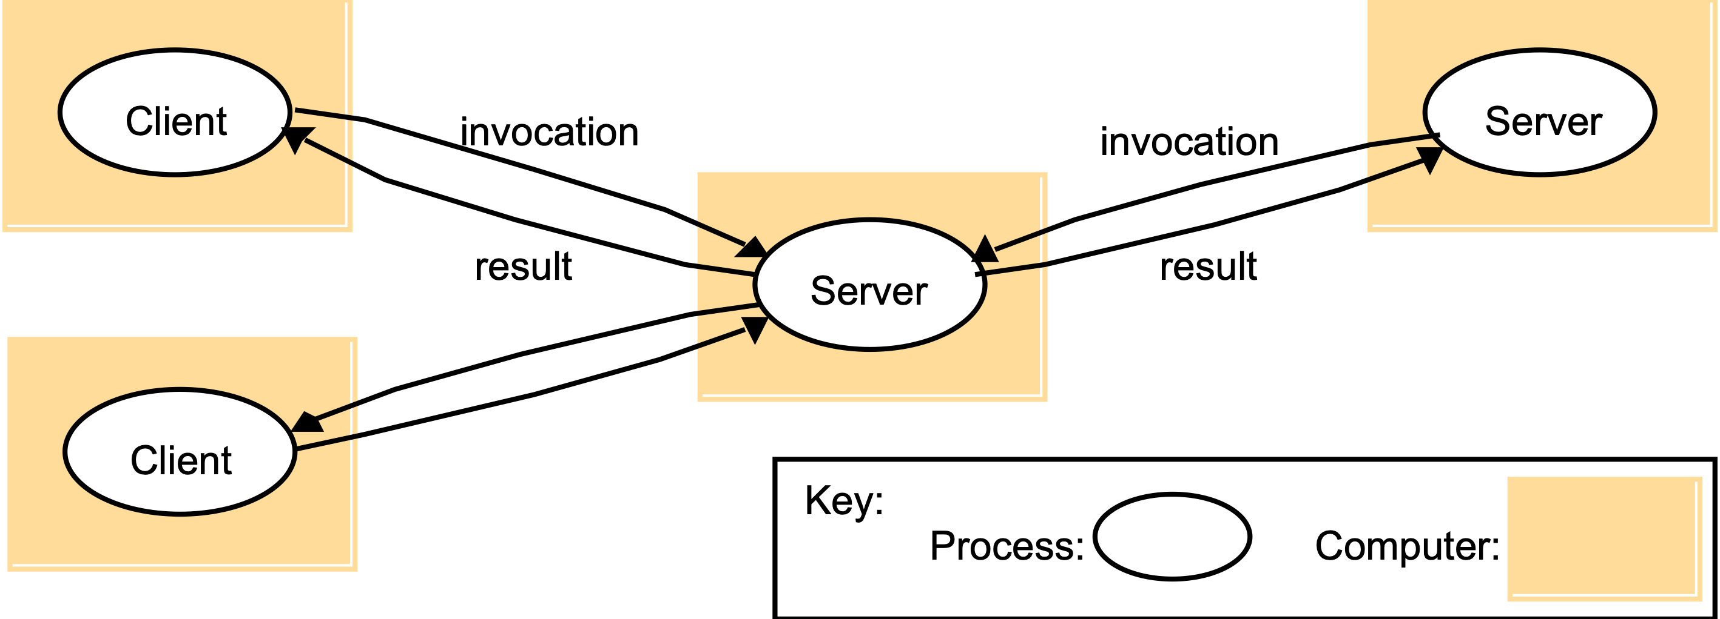
4.4.1 CLIENTS INVOKE INDIVIDUAL SERVERS

Slide 20
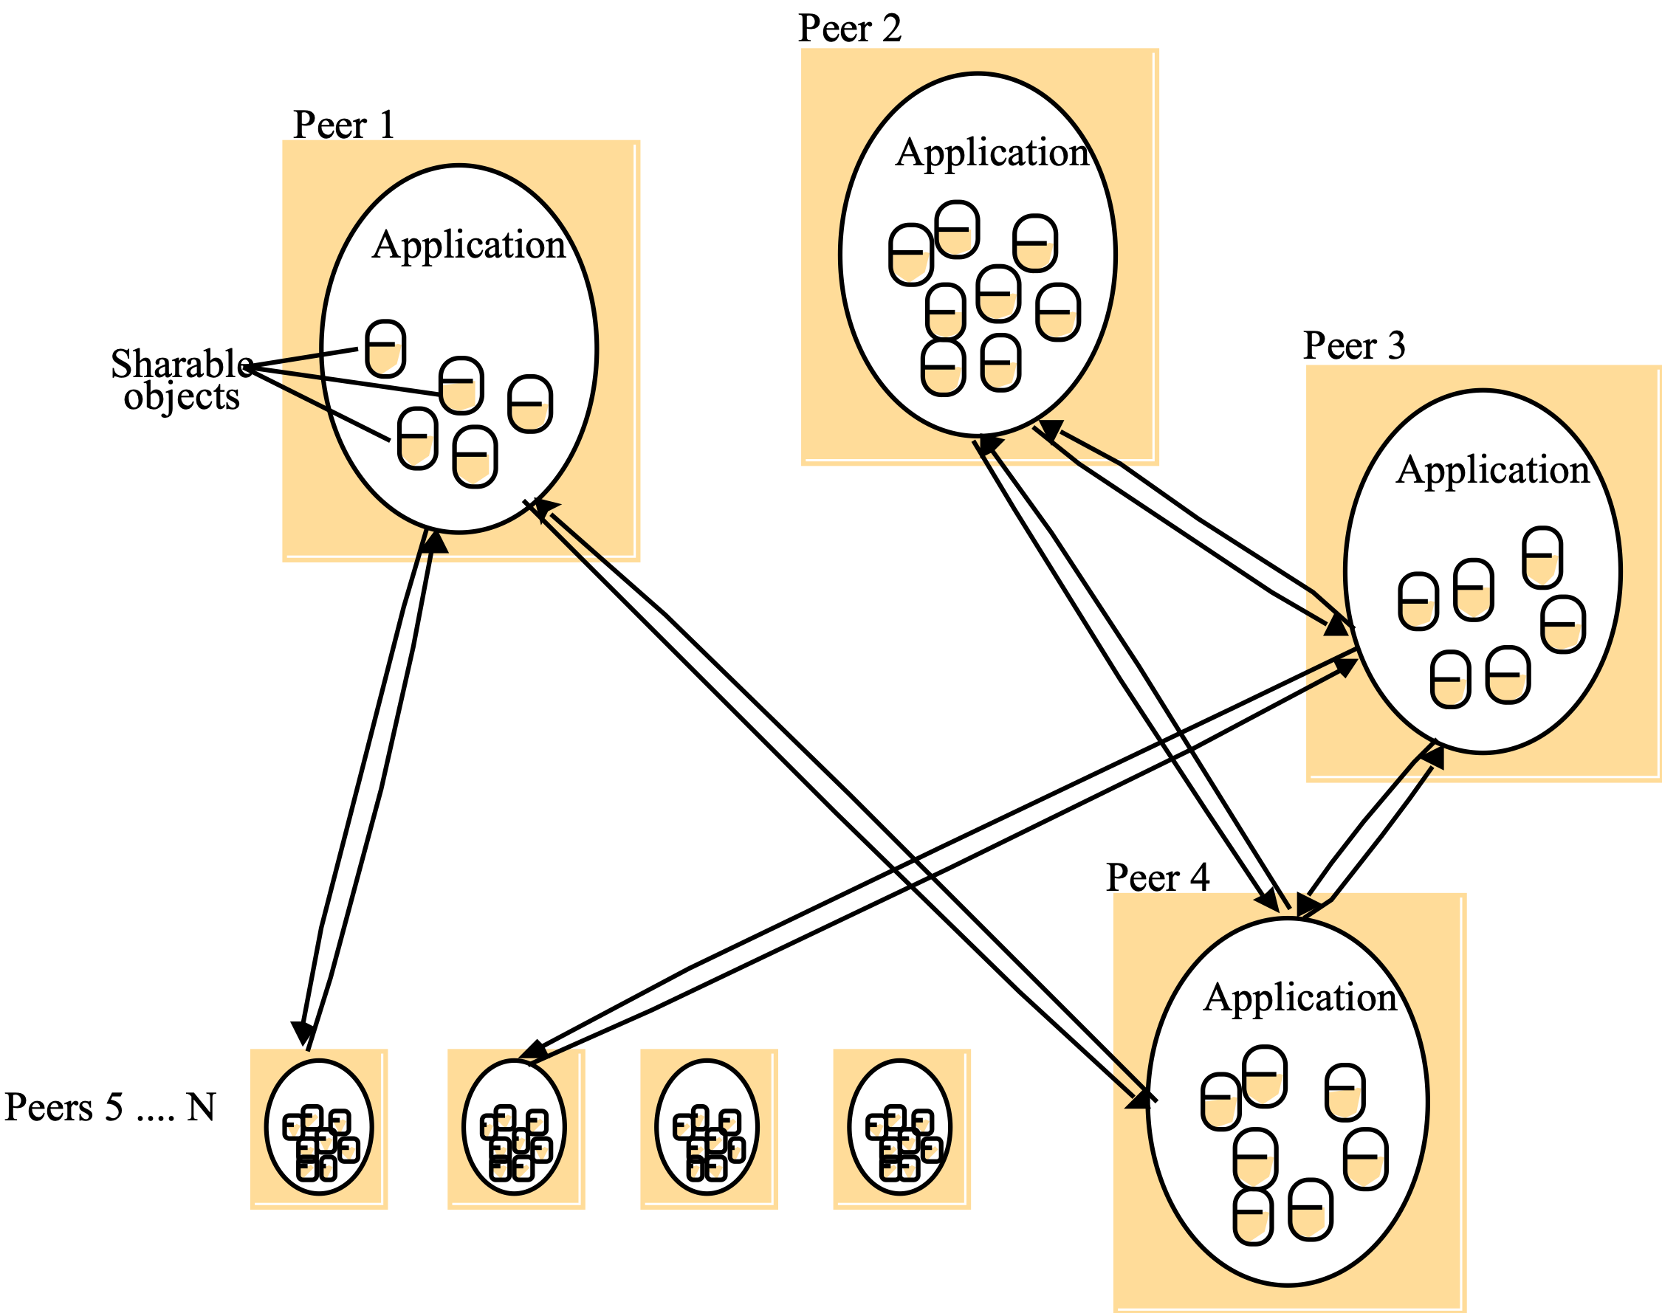
4.4.2 PEER-TO-PEER SYSTEMS

Slide 21
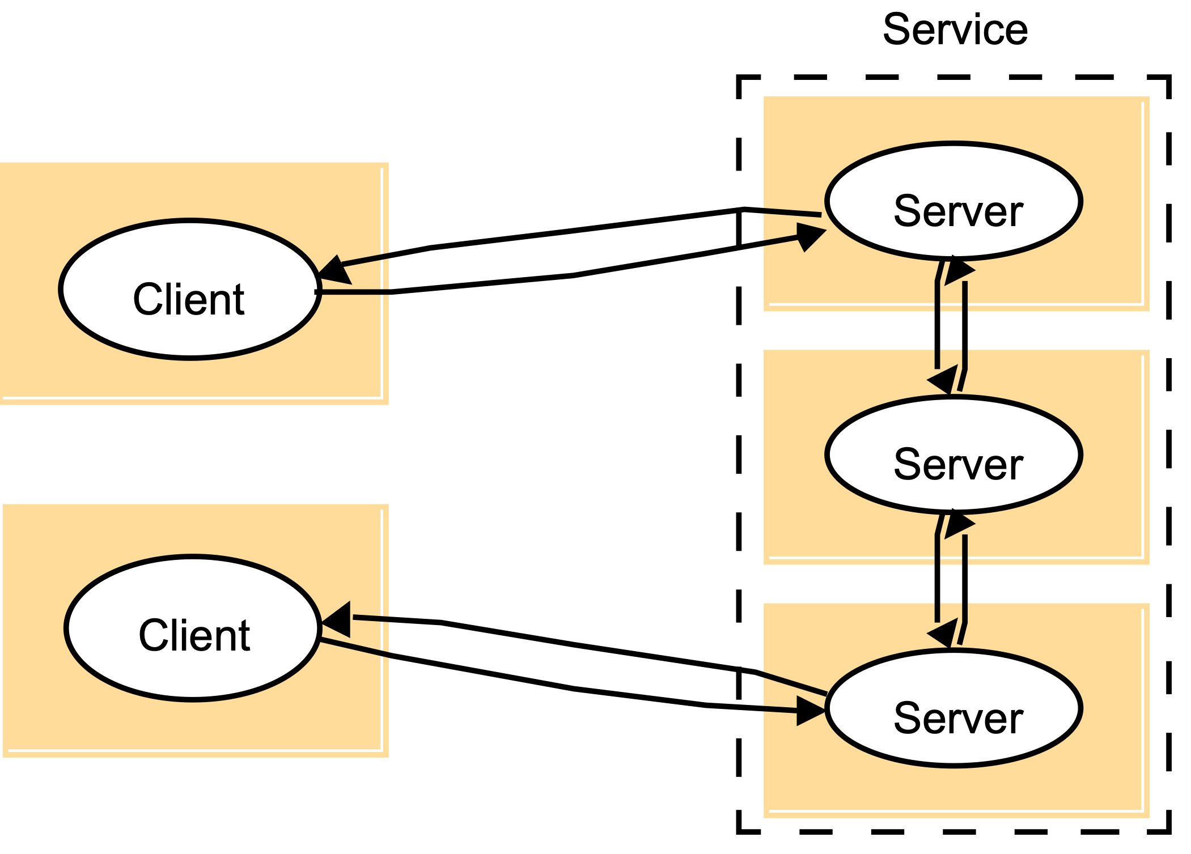
4.4.3 A SERVICE BY MULTIPLE SERVERS
Notes:
Load sharing
Redundancy

Slide 22
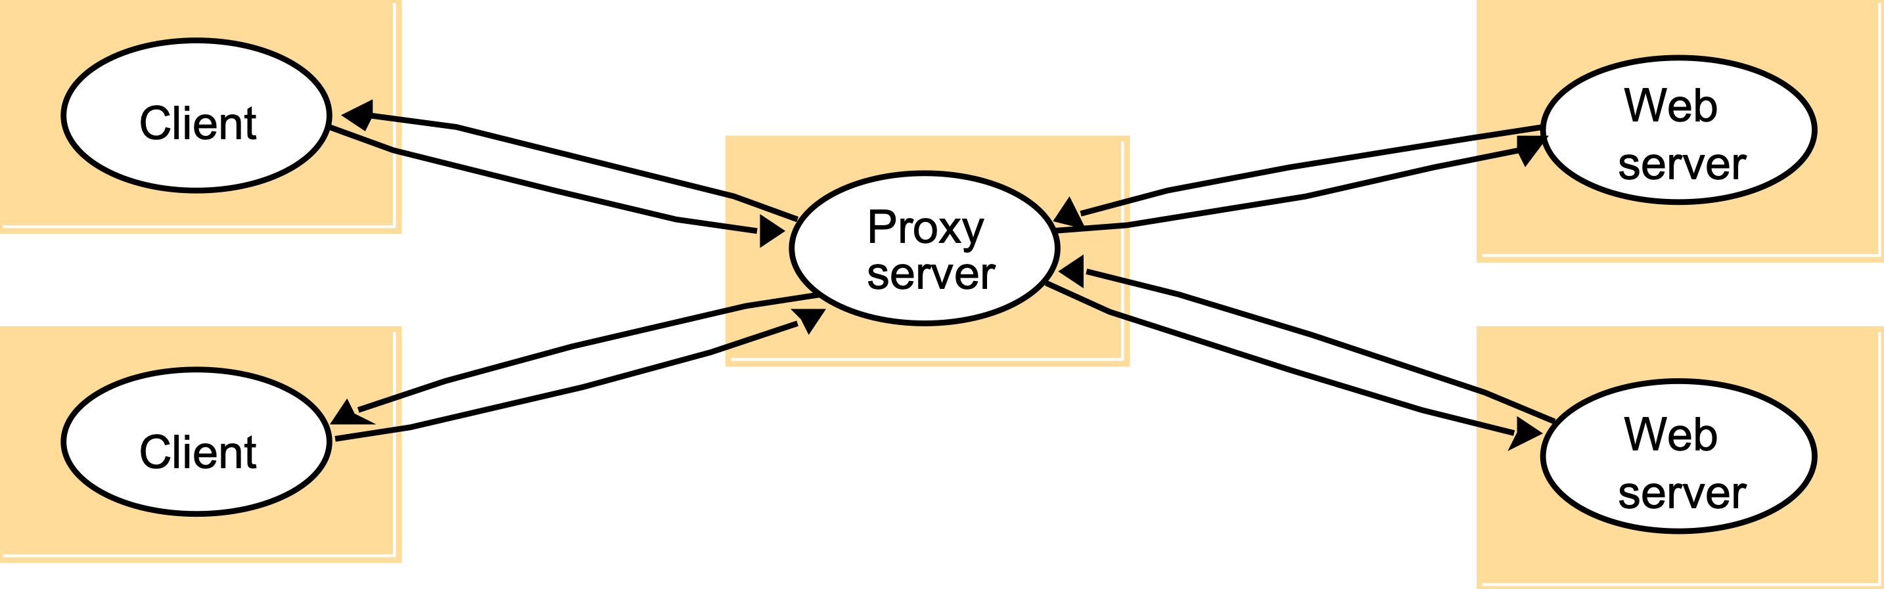
4.4.4 WEB PROXY SERVER

Slide 23
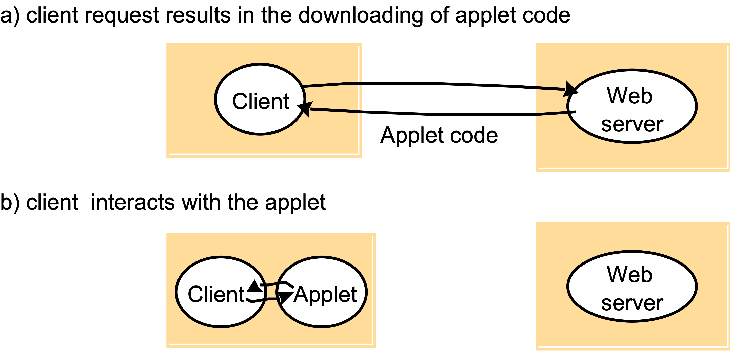
4.4.5 WEB APPLETS

Slide 24
4.4.6 THIN CLIENTS AND COMPUTE SERVERS
Compute server
Network computer or PC
network
Application
Thin
Process
Client

